Slide 1
Sales Dashboard Summary
By Kesav B M | Data Analyst Internship

Slide 2
Objective
Create an interactive dashboard to help business stakeholders understand sales performance.
Tools used: Power BI, Excel
Dataset: Superstore Sales Data

Slide 3
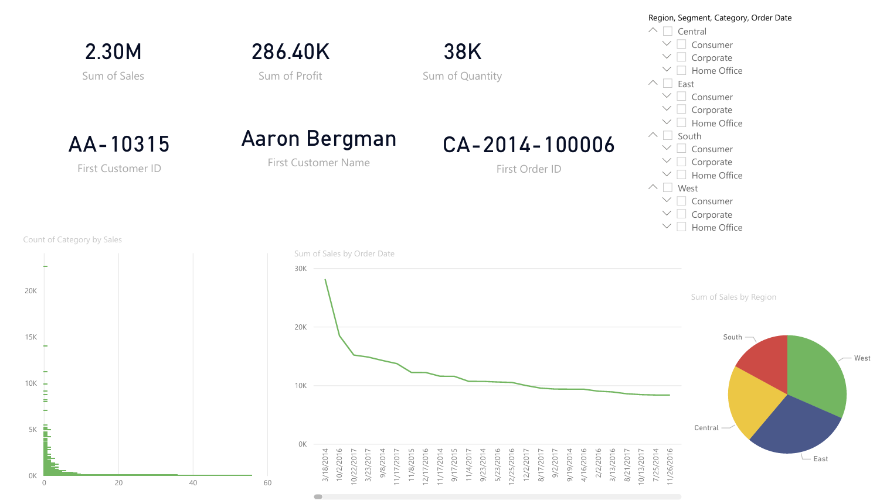
Dashboard screenshot

Slide 4
Key KPIs and Visuals
• Total Sales, Total Profit, Total Orders, Total Customers
• Time-Series Line Chart for Sales Trends
• Category-wise Sales Bar Chart
• Region-wise Sales Pie Chart
• Filters: Region, Category, Segment, Order Date

Slide 5
Insights & Interactivity
• Most profitable region and category identified
• Seasonal sales trends observed
• Slicers enable business users to explore data interactively

